Slide 1


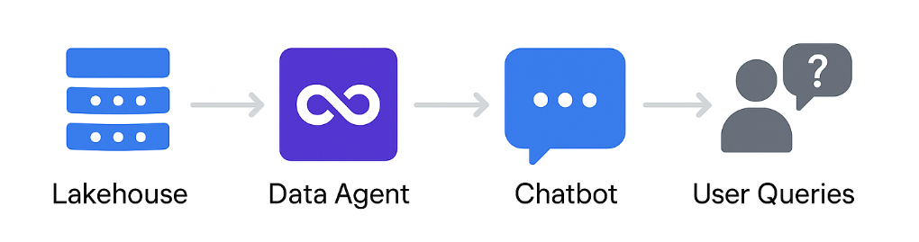

Creating chatbots was never that easy
Thanks to Fabric, it’s simple, faster, and accurate.
Let's Get Started!

Slide 2
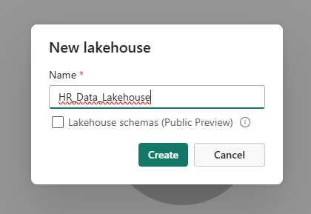
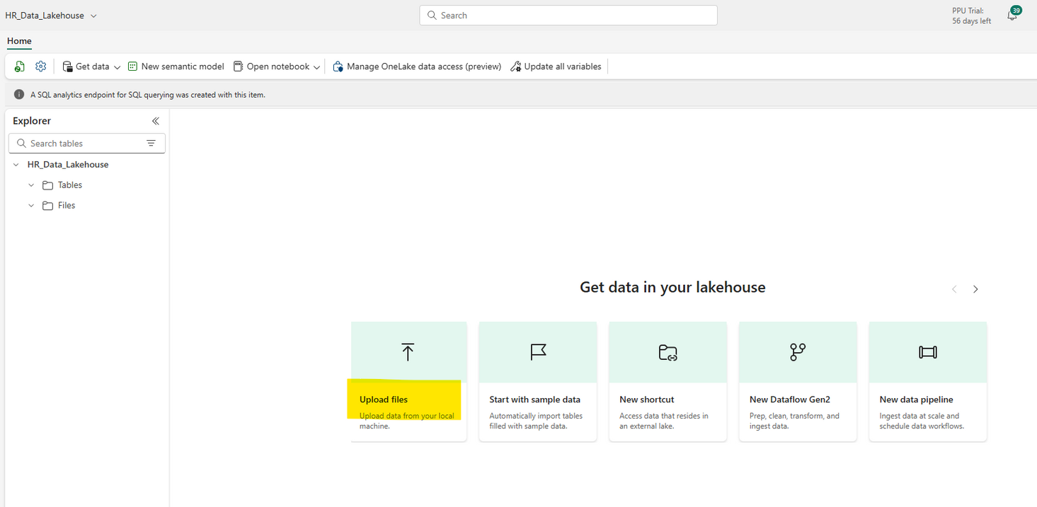
Cretae a Lakehouse in Fabric Workspace.
Upload the files to the Lakehouse.

Slide 3
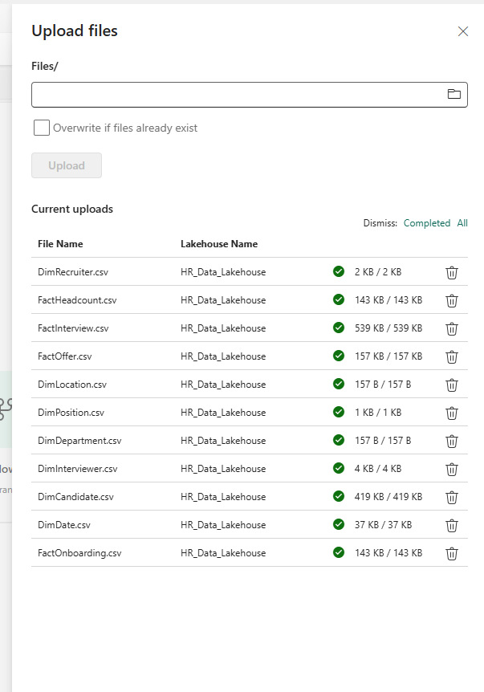
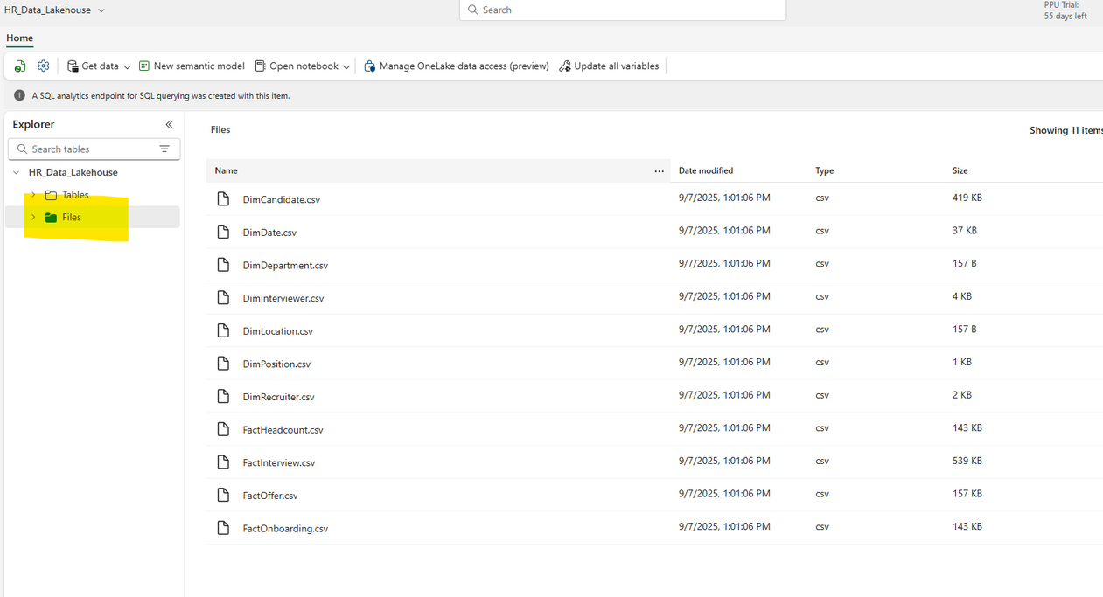
Files will be uploaded in the Files section in Parquet format. If you're unable to locate them, simply click the refresh button next to the settings icon.

Slide 4
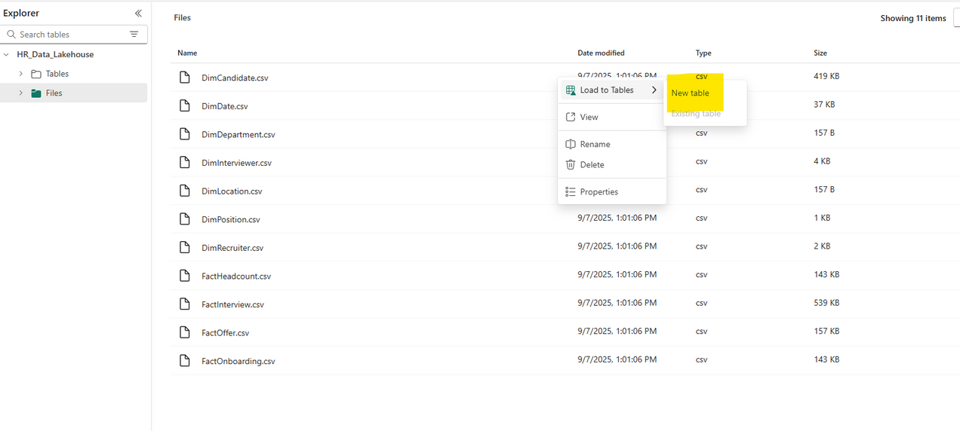
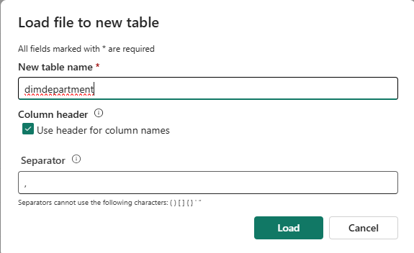
Click on the three dots next to each file and upload the file into the Delta table format.

Slide 5
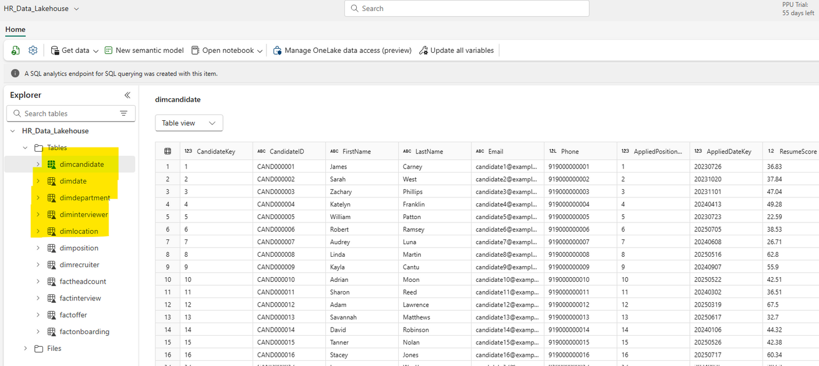
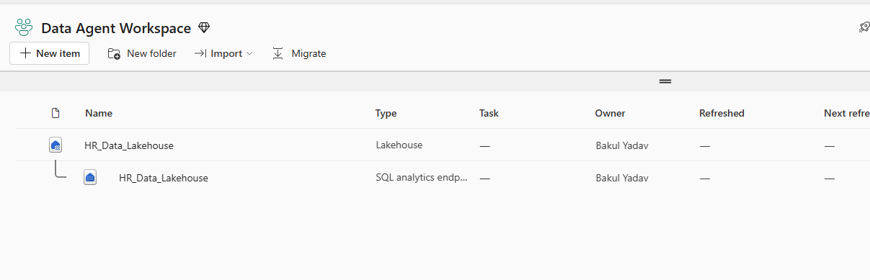
All the tables have been successfully placed into the table folder.
The Lakehouse is now equipped with the HR data, but it is not yet fully prepared.

Slide 6
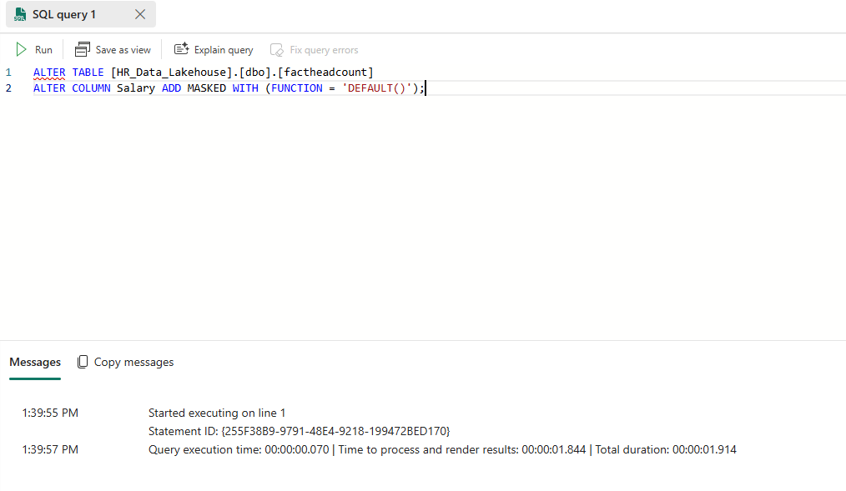
Protecting Sensitive Information with Data Masking
Certain tables contain sensitive information, such as employee salaries, which should not be visible to users with Viewer access. To ensure data privacy, column-level data masking is necessary. To implement this, open the SQL analytics endpoint and enter the following query in the query section and run the query.
I am currently applying masking on the Salary column; however, you can also mask multiple columns as needed.
ALTER TABLE [HR_Data_Lakehouse].[dbo].[factheadcount]
ALTER COLUMN Salary ADD MASKED WITH (FUNCTION = 'DEFAULT()');

Slide 7
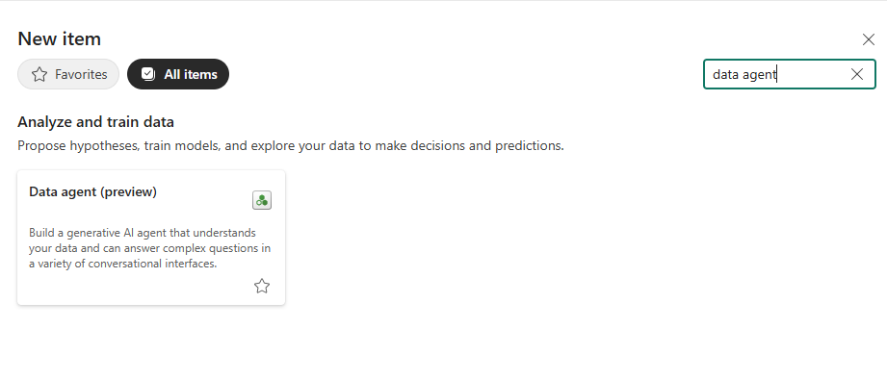
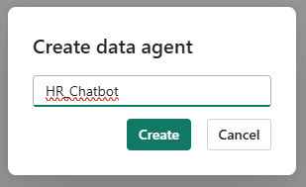
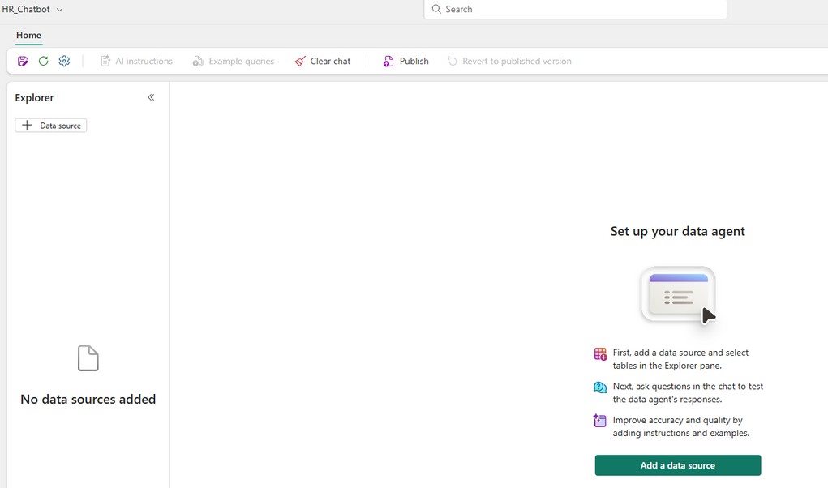
The Lakehouse has been finalized, so we will move forward by selecting "New Item" to create our data agent.
Now, click on the data source to connect the Chatbot with our Lakehouse.

Slide 8
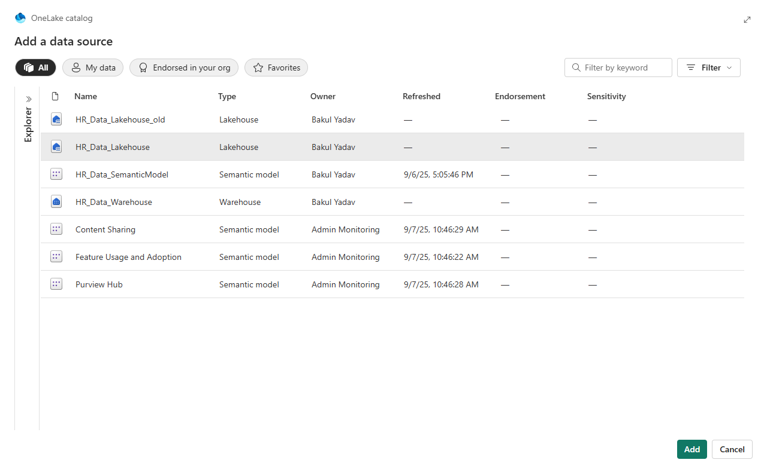
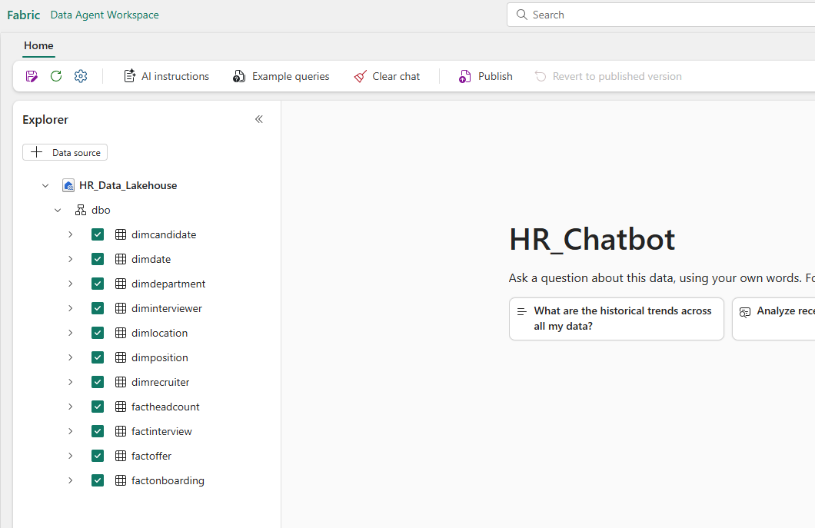
Choose the lakehouse and proceed to add it.
Once added, choose the tables you wish to grant access to the data agent. I have selected all the tables.

Slide 9
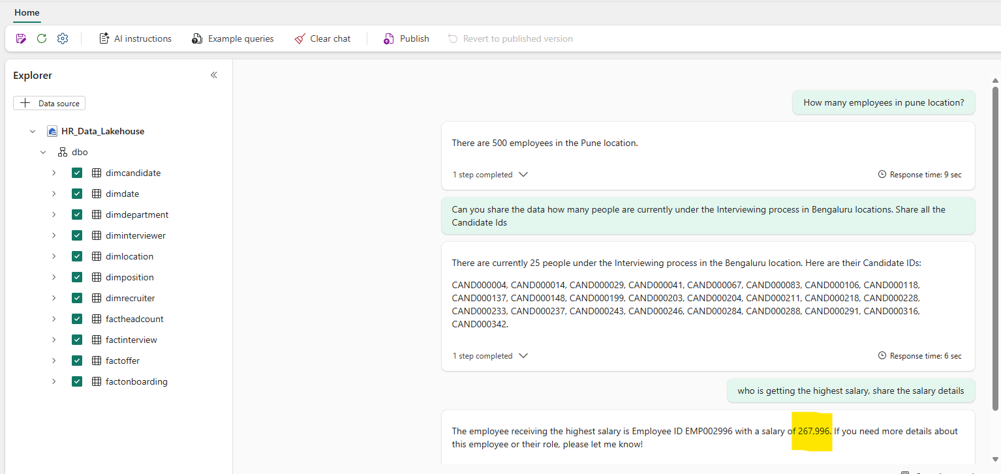
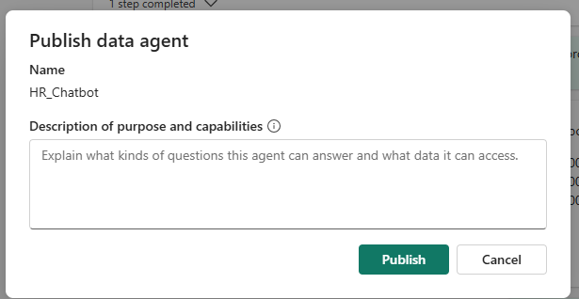
The chatbot is now fully operational, so feel free to ask any questions related to the data.
The chatbot is now providing accurate responses to queries. We can proceed to publish the chatbot by clicking the Publish button.

Slide 10
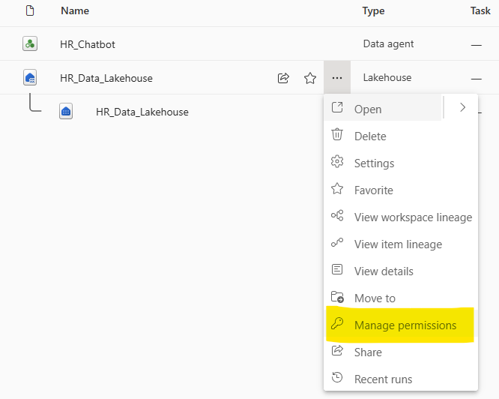
Since I have admin access, I can view the salary details of the employee. Let’s grant Viewer access to another individual. We will pose the same questions to the Chatbot using the Viewer credentials to verify whether they can access the salary information.
To grant Viewer access for HR_Chatbot, navigate to the manage permissions section of Chatbot & Lakehouse and enter the email address of the individual you wish to authorize.
To add a user, click on Direct Access and then select Add User. Be sure to grant them Viewer access.

Slide 11
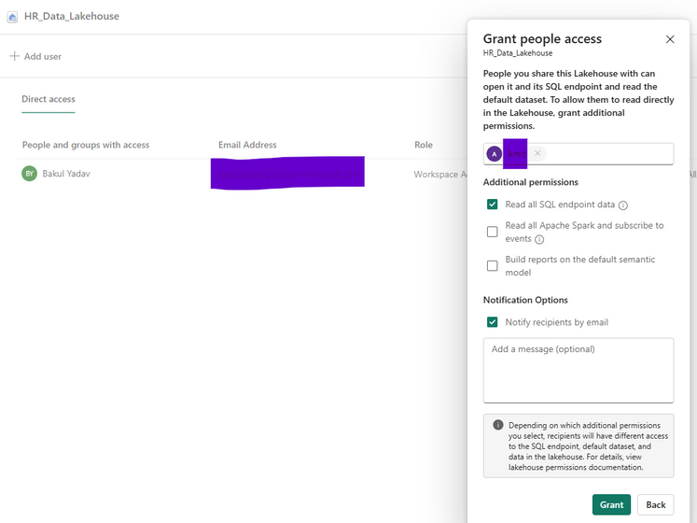
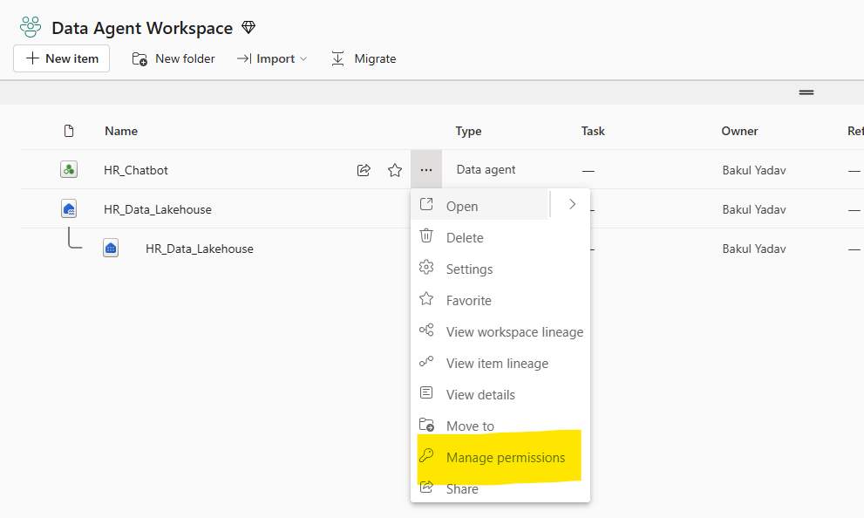
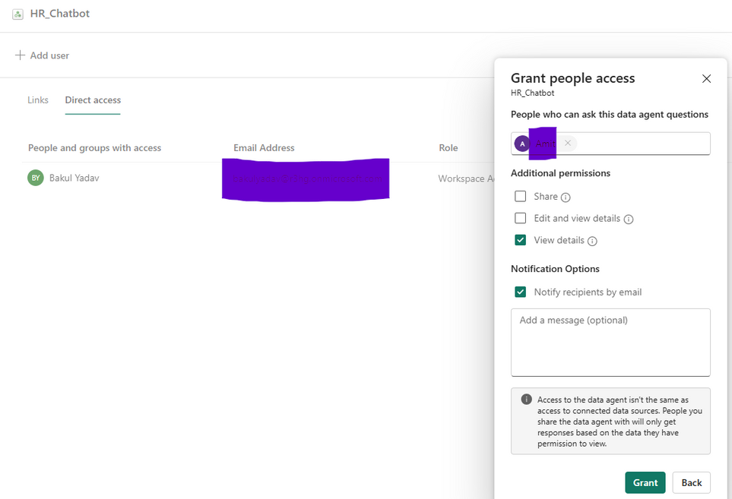

Slide 12
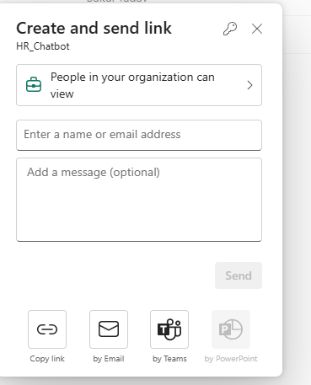
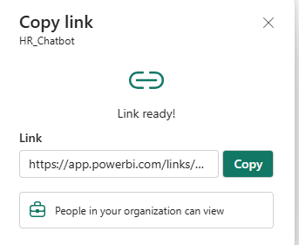
Now share the Chatbot link with user.

Slide 13
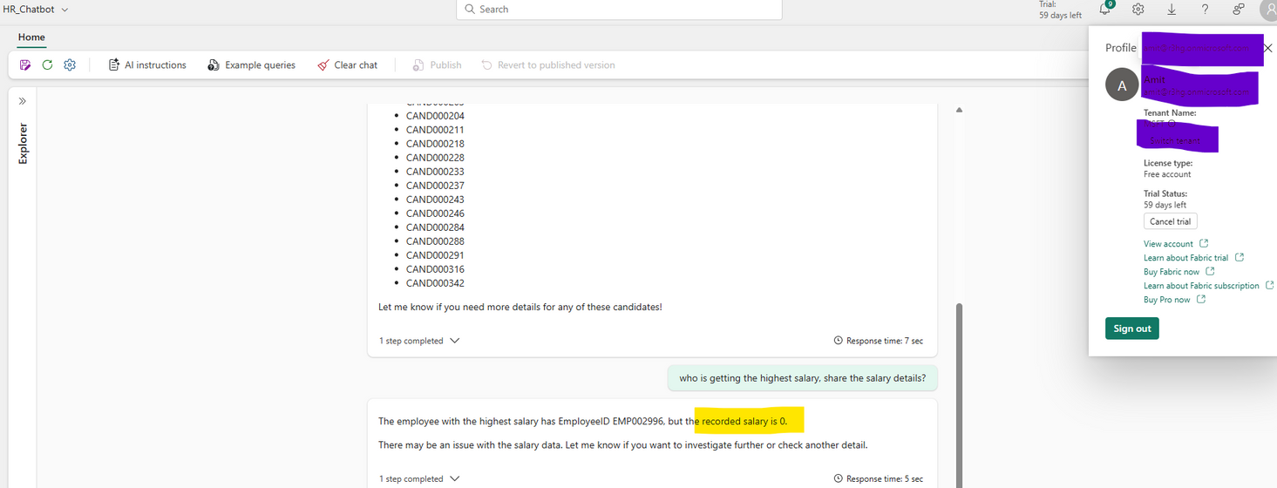

Please log in using user’s credentials and then proceed to ask the same questions.
For the viewer, the displayed salary appears as 0. The data masking is functioning correctly as well.

